Slide 1
Indexing and M-way Search Trees

Slide 2
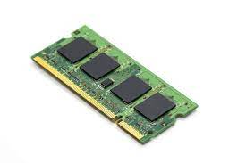

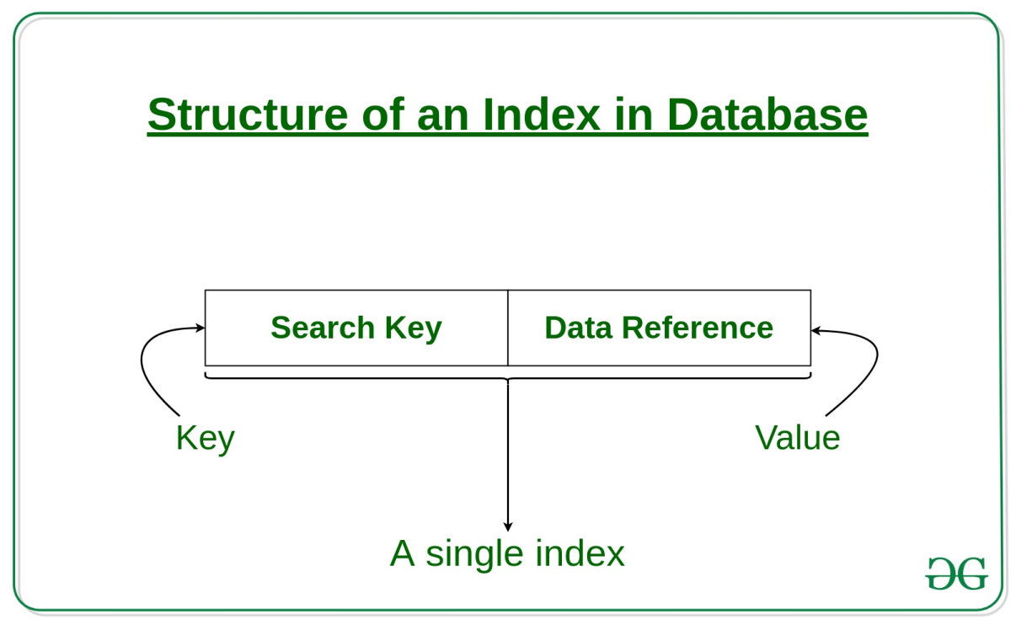
Memory Types & Data Organization
Main Memory
(RAM)
Data Structure
Secondary memory
(Hard Disk)
DBMS

Slide 3
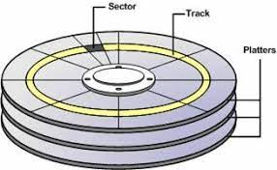
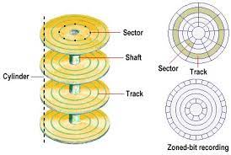
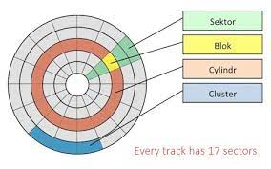
Disk Internal Structure
Each platter of a hard disk is divided into a number of concentric tracks.
Each track is divided into a number of sectors, each of which can store the same amount of data.
A sector is the smallest physical storage unit on the disk, and on most file systems it is fixed at 512 bytes in size.

Slide 4
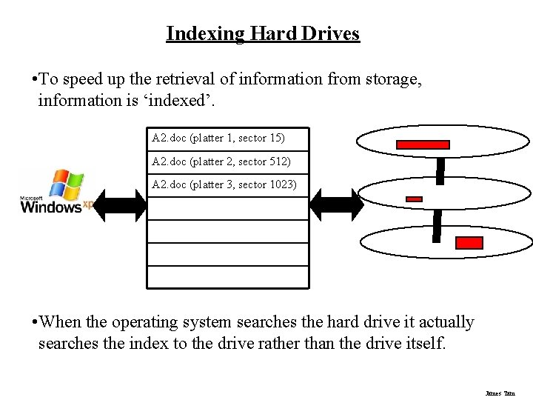
What Does Indexing Do?
Indexing is the way to get an unordered table into an order that will maximize the query’s efficiency while searching.

Slide 5
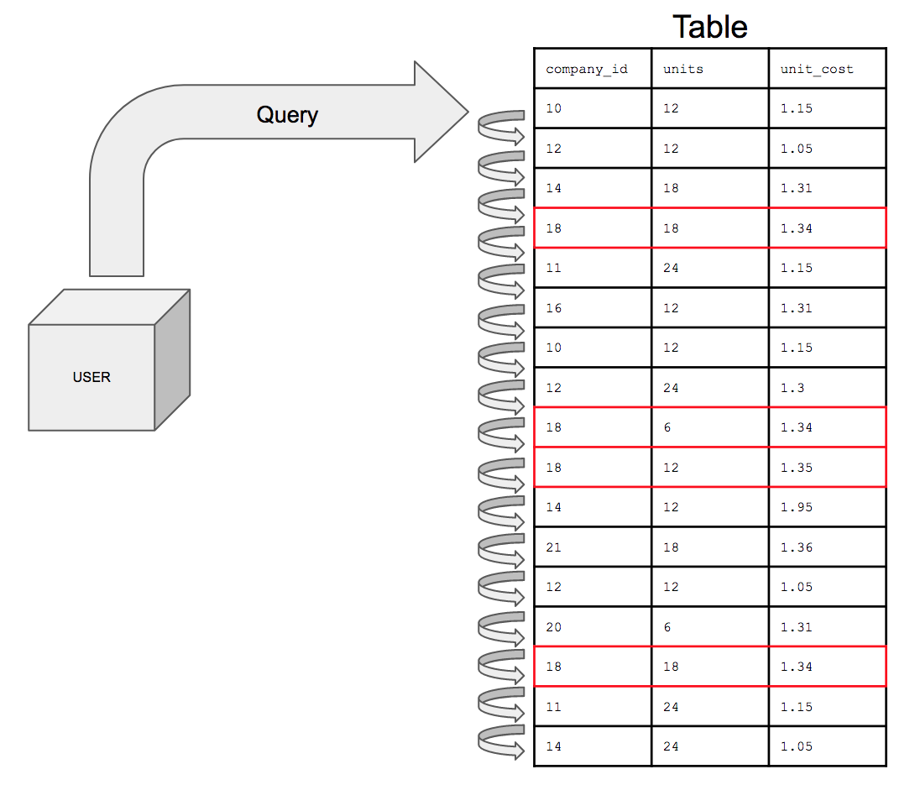
Search record with company_id =18
When a table is unindexed
the queries will have to search through every row to find the rows matching the conditions.
Looking through every single row is not very efficient.

Slide 6
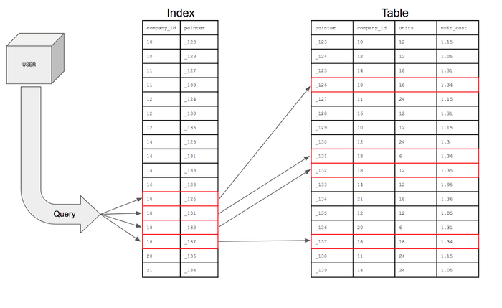
With an index on the company_id column, the table would be like this
When a table is Indexed

Slide 7

Understanding Indexing
A database of 200 records stored where each record requires 128 bytes
Assuming each sector is 512 bytes
Therefore 1 sector represents 4 records
So, entire database requires = 200 /4 = 50 sectors
(thus 50 hard-disk read operations)
With Indexing
Indexing is done for each record and assume each index entry require 4 bytes
Therefore for 200 record it need 200*4= 800 bytes
Extra sector required for index entry 800/512 = 2 sectors
So total 2+ 1 = 3 reads are required to get the data

Slide 8
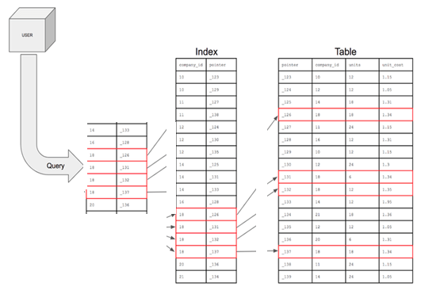
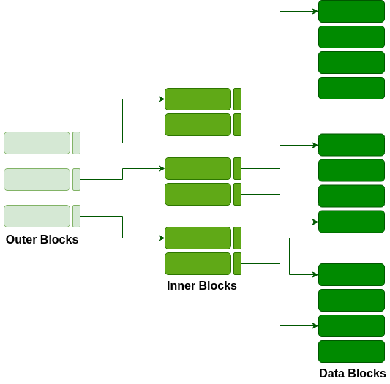
Multilevel Indexing
(When data size is too large)
Lets assume now to store 2000 records , which requires 2000/4 = 500 sectors
Indexing will requires 2000*4 = 8000 => 8000/512 = 16 sectors
Total read operations 16 + 1 = 17 sector
Efficient approach is to make one more index for each sector
Extra sector required for index entry 16*4/512 = 1 sectors ( assume one entry for each sector)
So total 1 + 1 +1 = 3 reads are required to get the data

Slide 9
Multilevel Indexing
As the index is stored in the main memory, a single-level index might become too large a size to store with multiple disk accesses.
The multilevel indexing segregates the main block into various smaller blocks so that the same can stored in a single block.
The outer blocks are divided into inner blocks which in turn are pointed to the data blocks.
This can be easily stored in the main memory with fewer overheads.

Slide 10
Indexing
Indexing adds a data structure with columns for the search conditions and a pointer
The pointer is the address on the memory disk of the row with the rest of the information
The index data structure is sorted to optimize query efficiency
The query looks for the specific row in the index; the index refers to the pointer which will find the rest of the information.
The index reduces the number of rows the query has to search

Slide 11
M-way Trees
A binary search tree has one value in each node and two subtrees.
This notion easily generalizes to an M-way search tree, which has (M-1) values per node and M subtrees.
M is called the degree of the tree. A binary search tree, therefore, has degree 2.
it is not necessary for every node to contain exactly (M-1) values and have exactly M subtrees.
In an M-way subtree a node can have anywhere from 1 to (M-1) values, and the number of (non-empty) subtrees can range from 0 (for a leaf) to 1+(the number of values).
M is thus a fixed upper limit on how much data can be stored in a node.

Slide 12

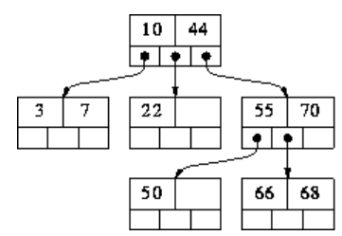
The values in a node are stored in ascending order, V1 < V2 < ... Vk (k <= M-1) and the subtrees are placed between adjacent values, with one additional subtree at each end.
We can thus associate with each value a `left' and `right' subtree.
In practice, M is usually very large.
Each node corresponds to a physical block on disk, and M represents the maximum number of data items that can be stored in a single block.
M is maximized in order to speedup processing:
to move from one node to another involves reading a block from disk
Reading from disk is very slow operation compared to moving around a data structure stored in memory.

Slide 13
Algorithm for searching for a value in an M-way search tree
Searching for value X and current node consisting of values V1...Vk
Four possible cases that can arise:
If X < V1, recursively search for X in V1's left subtree.
If X > Vk, recursively search for X in Vk's right subtree.
If X=Vi, for some i, then we are done (X has been found).
the only remaining possibility is that, for some i, Vi < X < V(i+1). In this case recursively search for X in the subtree that is in between Vi and V(i+1).

Slide 14
m-way trees have the following properties:
Each node has 0 .. m subtrees
A node with k < m subtrees, contains k-1 keys.
The key values of the first subtree are all less than the key value.
The data entries are ordered.
All subtrees are m-way trees.
As with binary search trees, inserting values in ascending order will result in a degenerate M-way search tree; i.e. a tree whose height is O(N) instead of O(logN).
This is a problem because all the important operations are O(height), and it is our aim to make them O(logN).
One solution to this problem is to force the tree to be height-balanced;

Slide 15
Construct a M-way Search Tree of order 3 by inserting following nodes
20, 30, 40, 50, 10, 15, 25, 45, 90, 105, 95, 80, 35
Construct a M-way Search Tree of order 4 by inserting following nodes
20, 30, 40, 50, 10, 15, 25, 45, 90, 105, 95, 80, 35

Slide 16
Video Lectures can be found at following link
M way Search tree
https://youtu.be/PHJY8EsyOlU

